Slide 1

Go Fund Me By Deepam Chetry
Reg No -12008097
Roll No - 06
Section –KM112

Slide 2
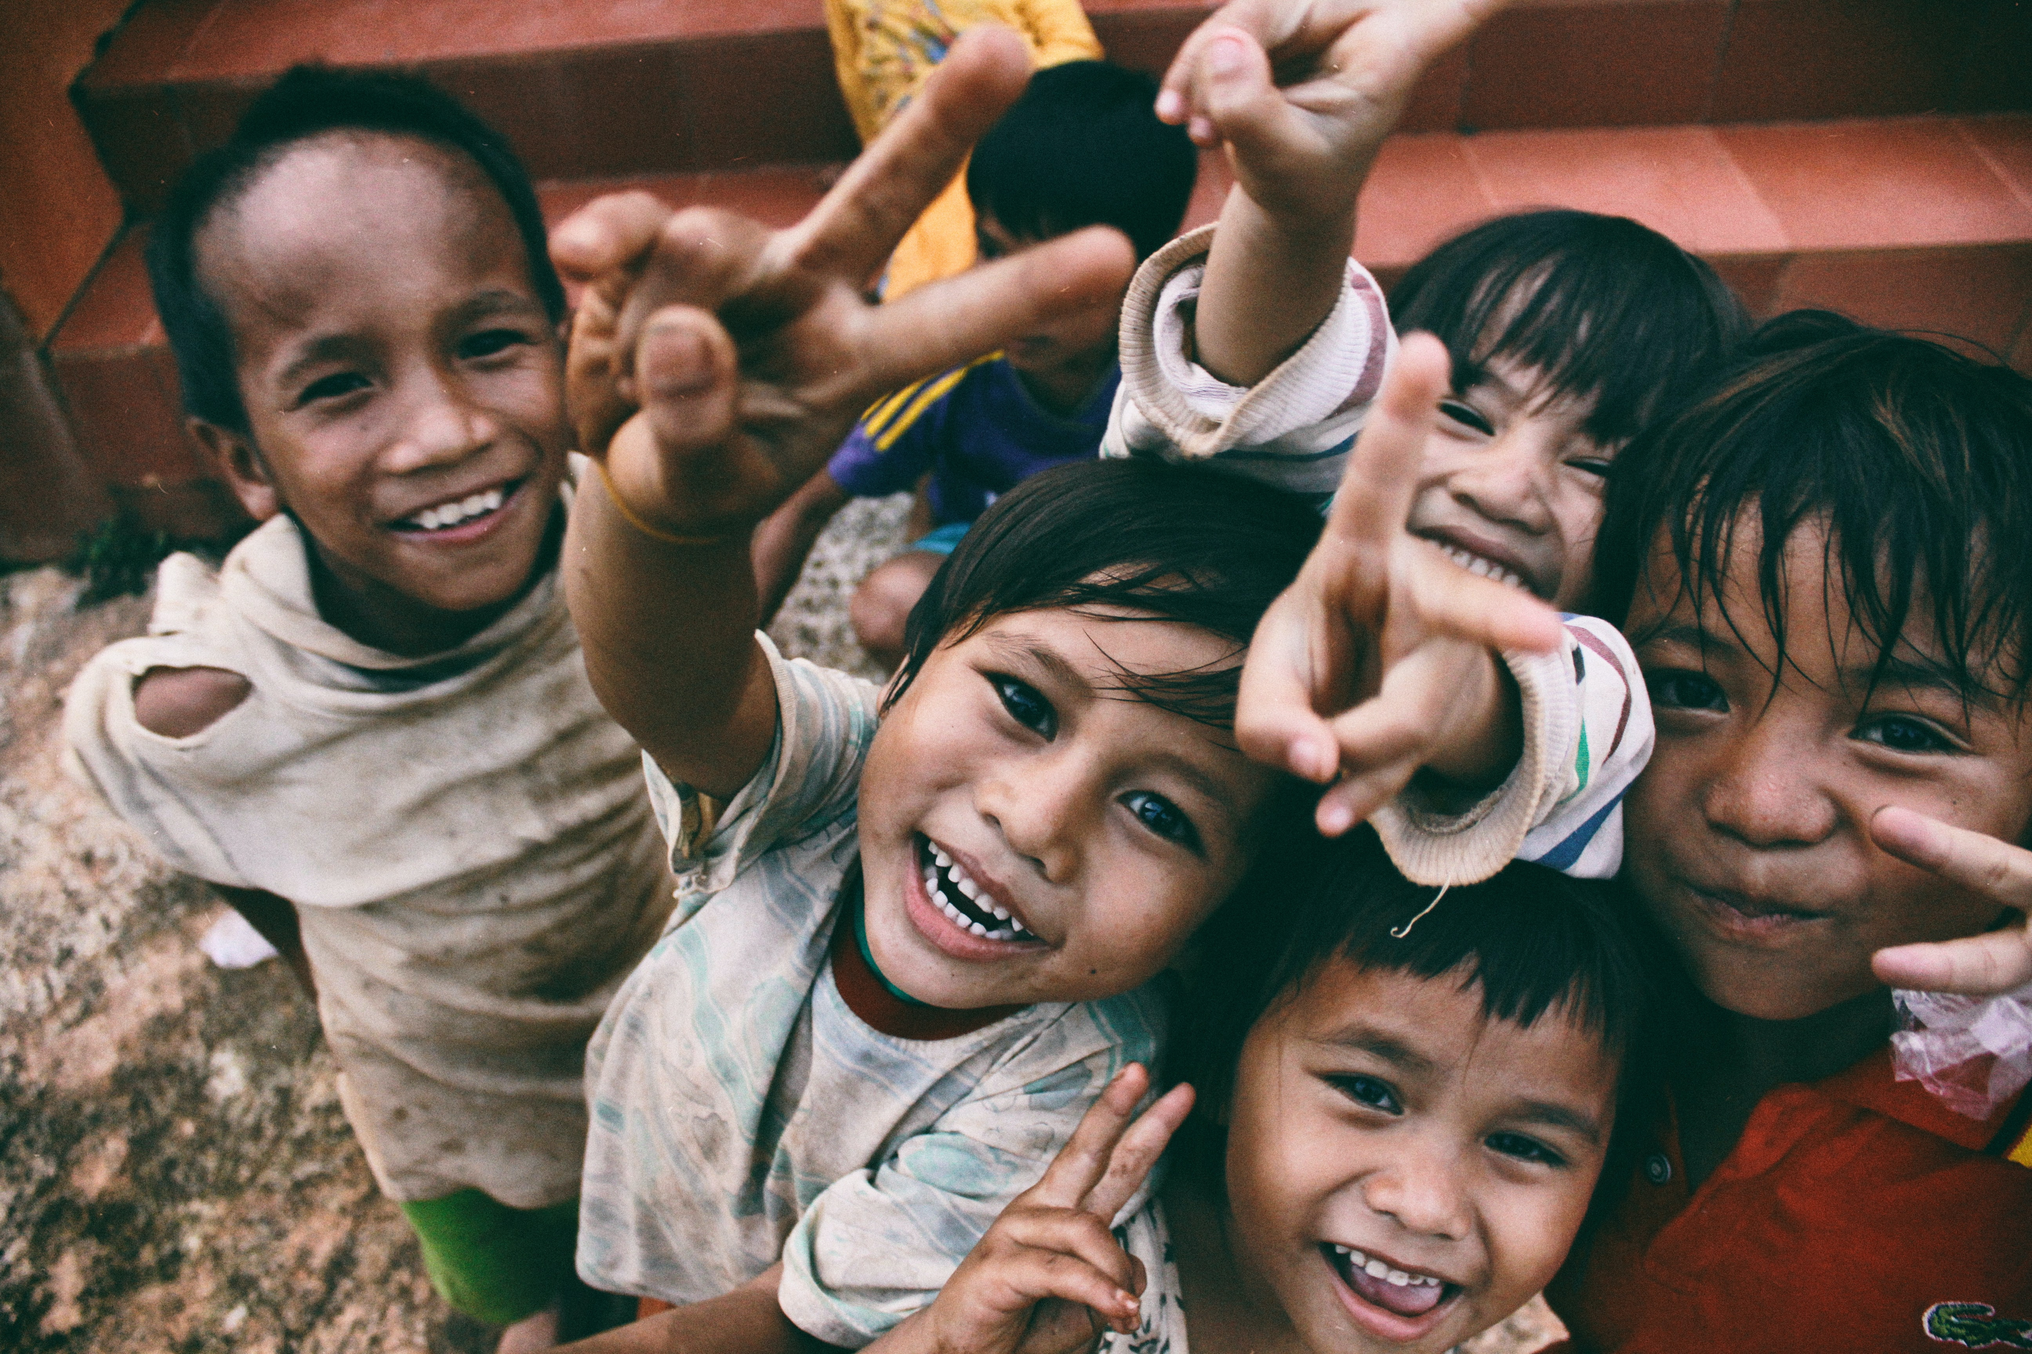
The Big concept
of GoFundME
“we create home for help”

Slide 3
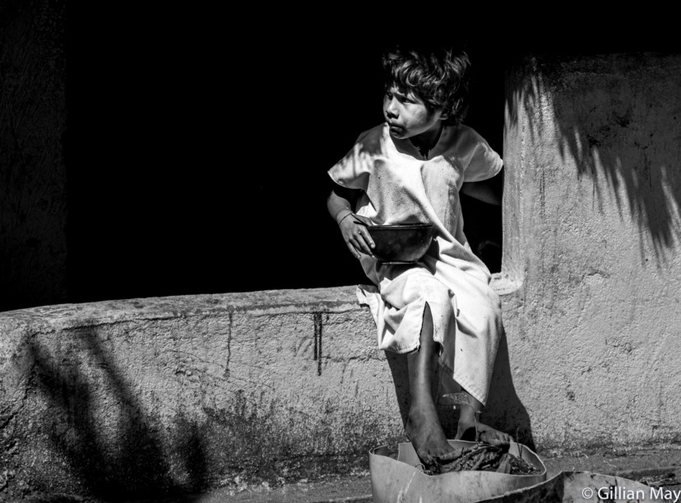
Abstract of project
This project is aimed to develop an online non profitable donation site which is easily accessible to the users.
The entire project has been developed keeping in view of the distributed client server computing technology, in mind.
Easy payment methods are implemented with integrated gateway on client sites

Slide 4
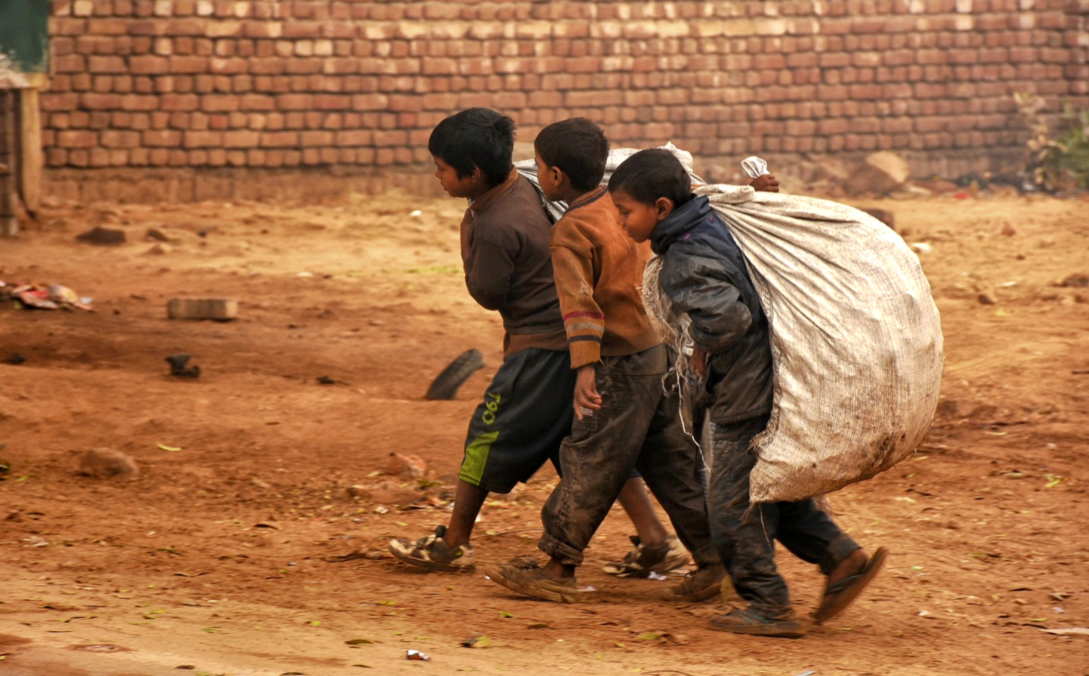
Abstract of project
Direct funding options are available for the users who are willing to donate a sum of money as a contribution to the less fortunate.
Other donation options like food, cloths, footwear, books are available to the end users too.
Through this website any person who is interested in donating can register themselves by submitting the required details for donations.
Technologies used are html, css, javascript, bootstrap and api for payment gateway

Slide 5

Drawbacks of existing projects
Initially
No multi platform payment gateway.
Which create a havoc in the funding system across different users for different regions of the country.
Secondary
There are options only for funds no other items for charity in the current website which is so orthodox.
Finally
Direct pick up of charity items or any other options for donations are not seen in action.

Slide 6
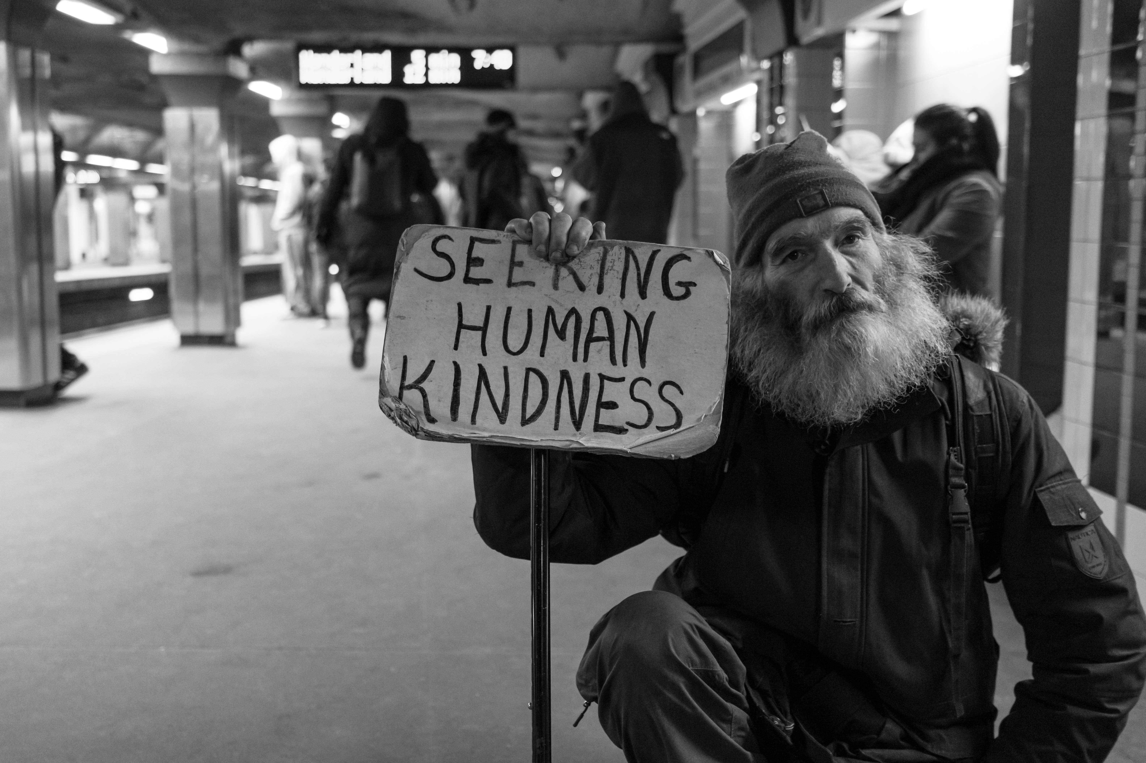
Advantages of the project
Flexible
The website is accessible across different devices without altering the real view.
User Friendly
Simple to use and has vivid range of options available to the users.
Multi Options
Multiple options for donations opens up new possibility.

Slide 7
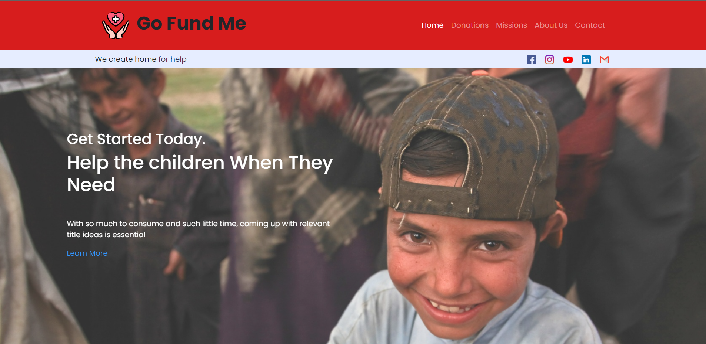
Desktop view
Place your screenshot here
Of Go fund me

Slide 8
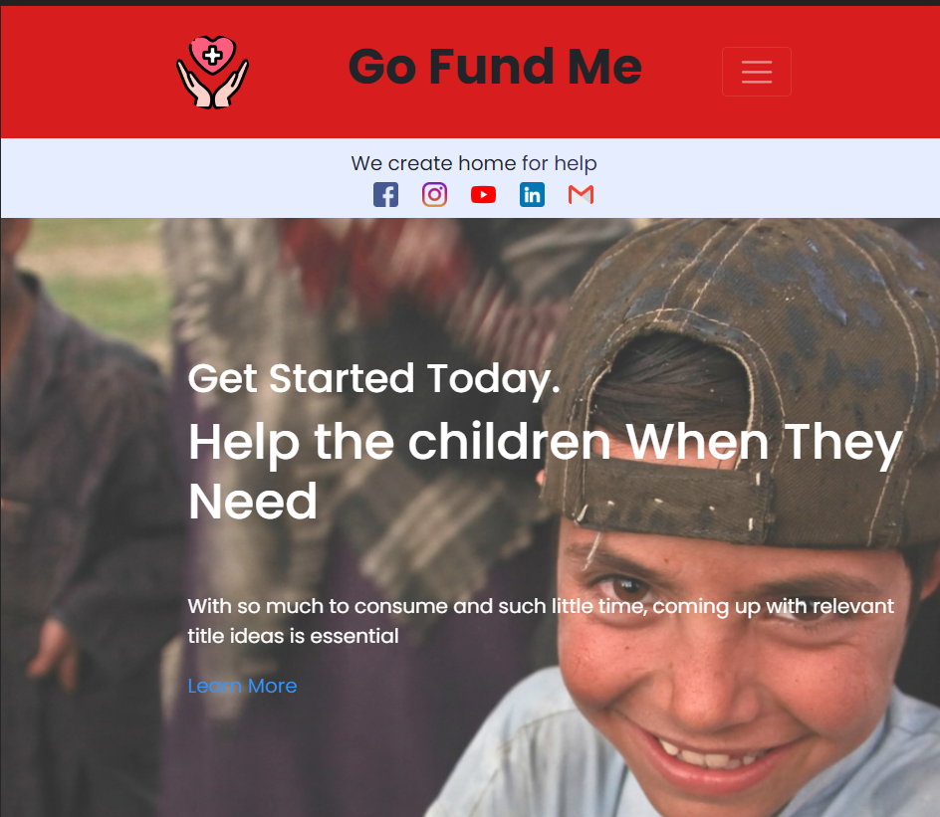
Tablet view project
Place your screenshot here
Of Go fund me
.

Slide 9
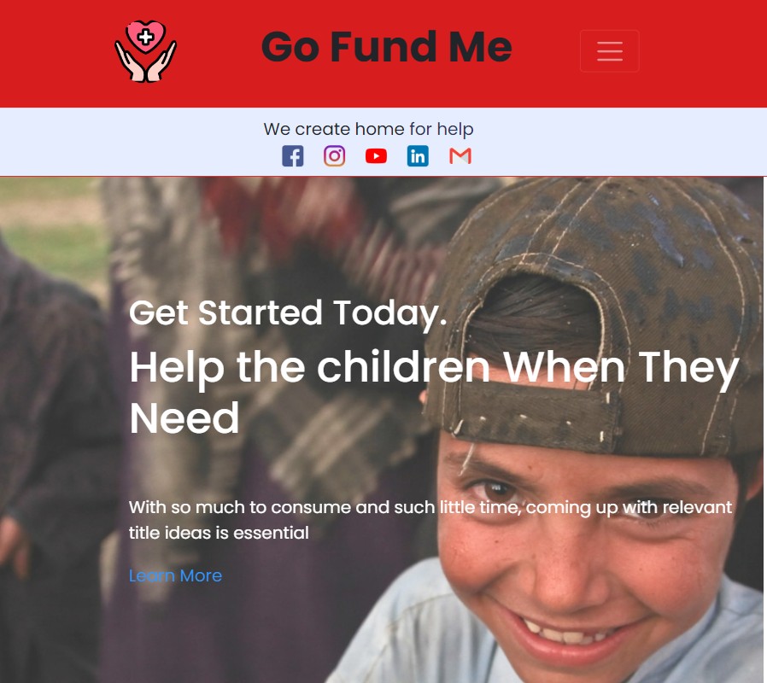
Mobile view
Place your screenshot here
Of Go fund me
.

Slide 10
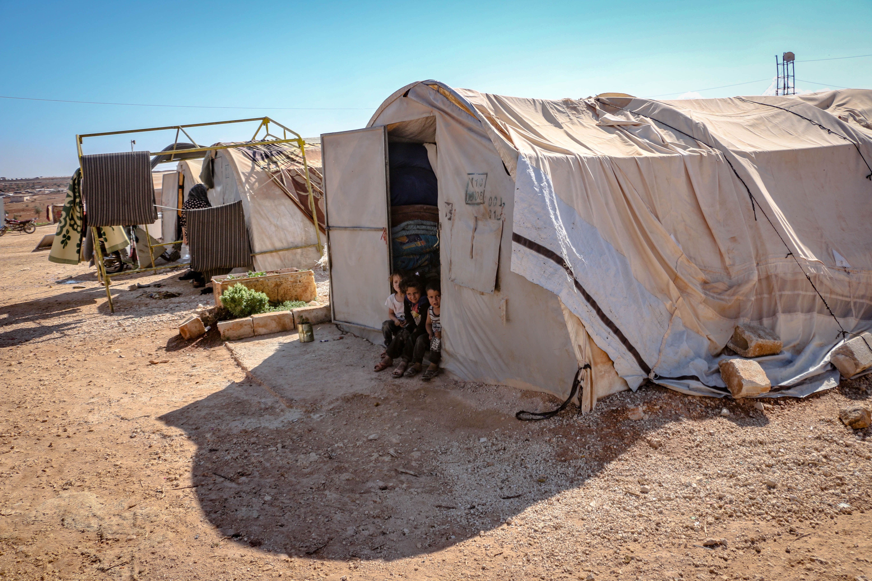
Advantages of the project
Dynamic & Responsive
Responsive design websites are easy to maintain.Easy in updating.
Non-Profitable Website
This was built for the
welfare of the people and the society.
Integrated Payment Gateway
Multiple payment methods make it easy for users.

Slide 11
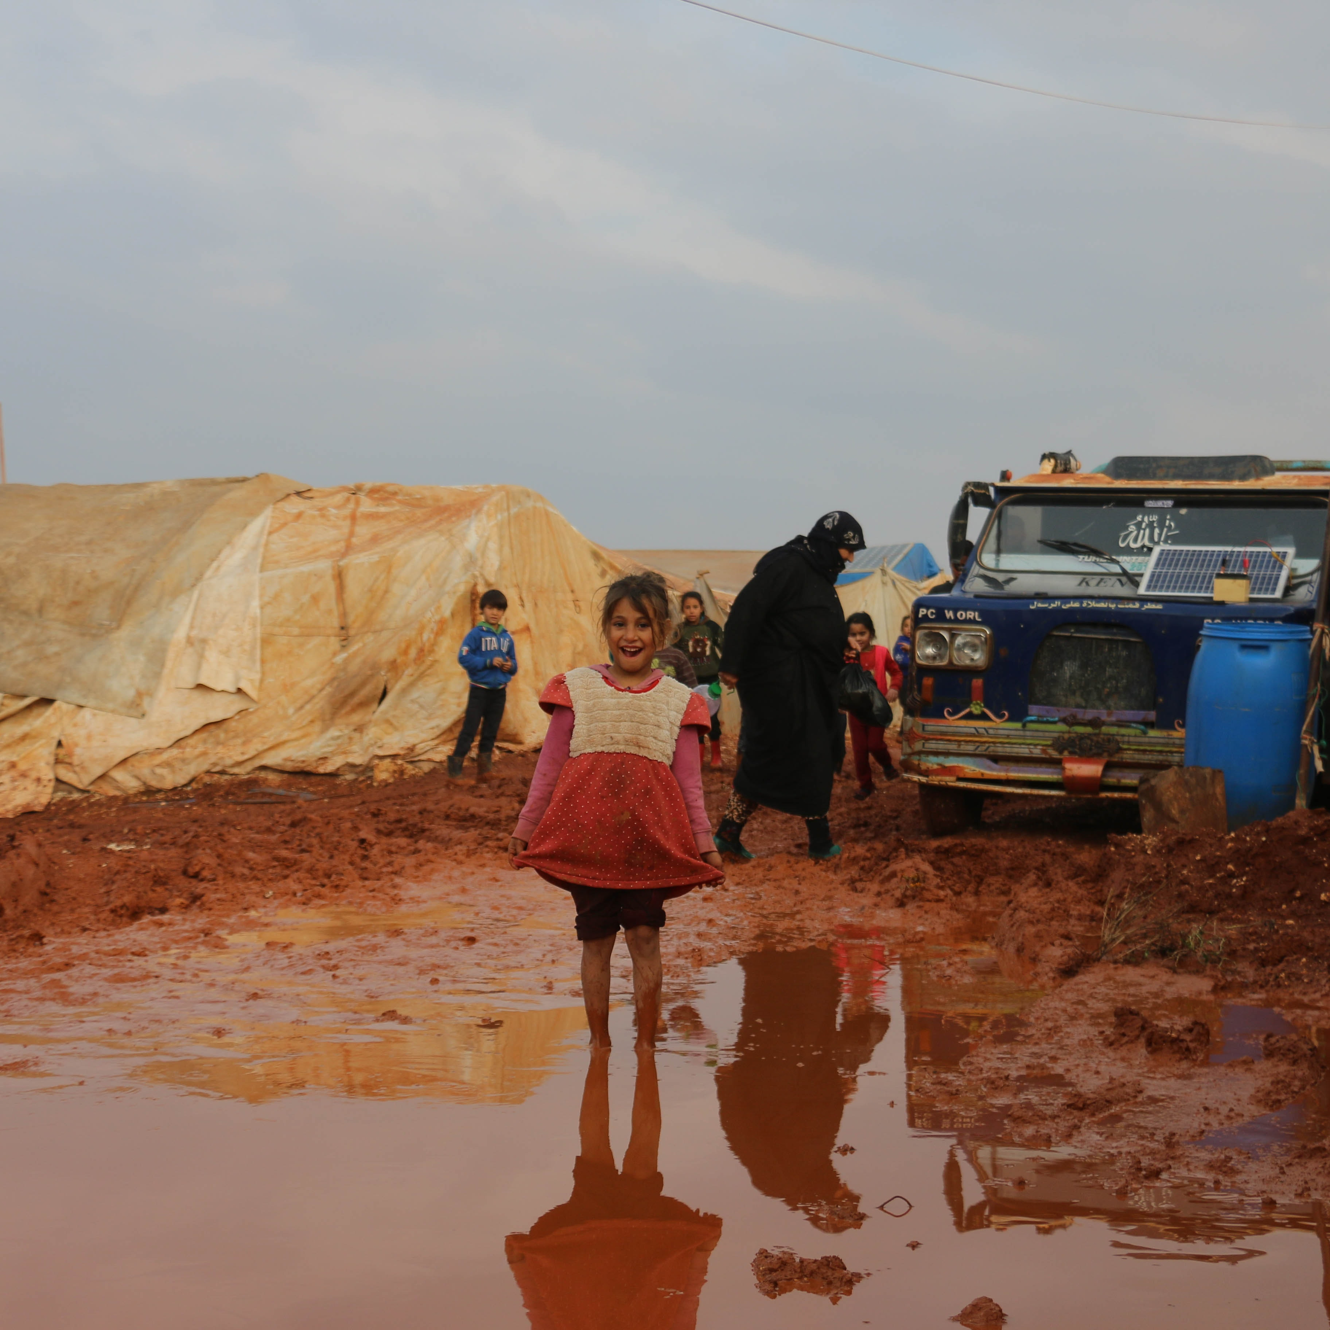
Project link
https://spontaneous-gnome-21cce0.netlify.app/

Slide 12
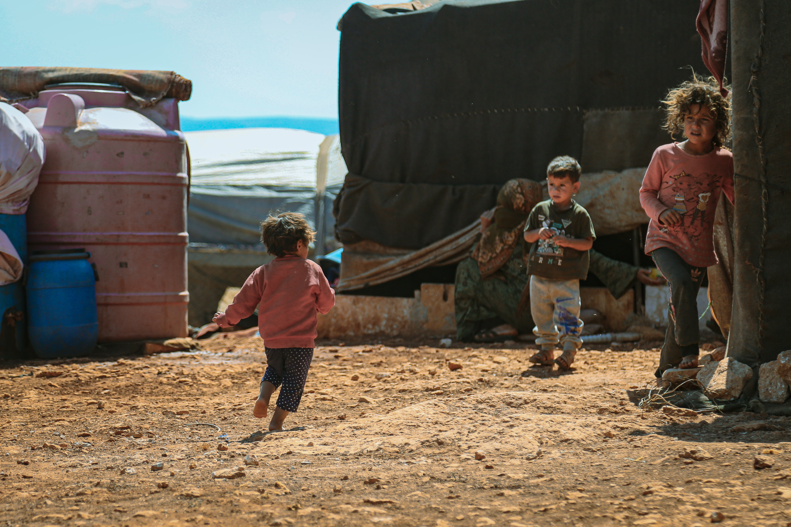
Any Queries??

Slide 13
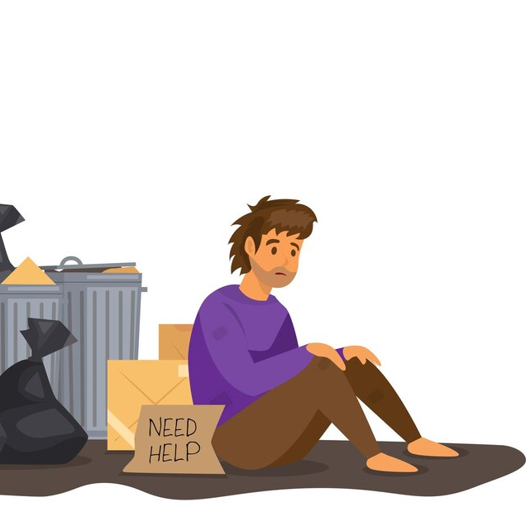
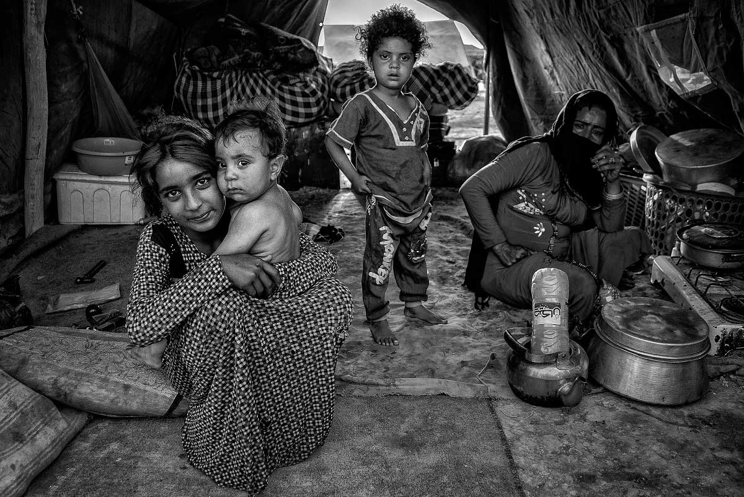
Thank YOU!
You can find me at:
@gofundme
Gofundme@gmail.com

